Slide 1
Price Visualizer: CPI & PPI Forecasting Tool
Keigen Godlaski

Slide 2
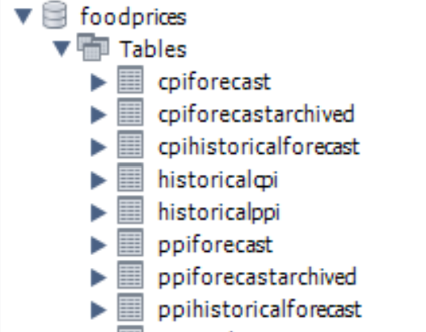
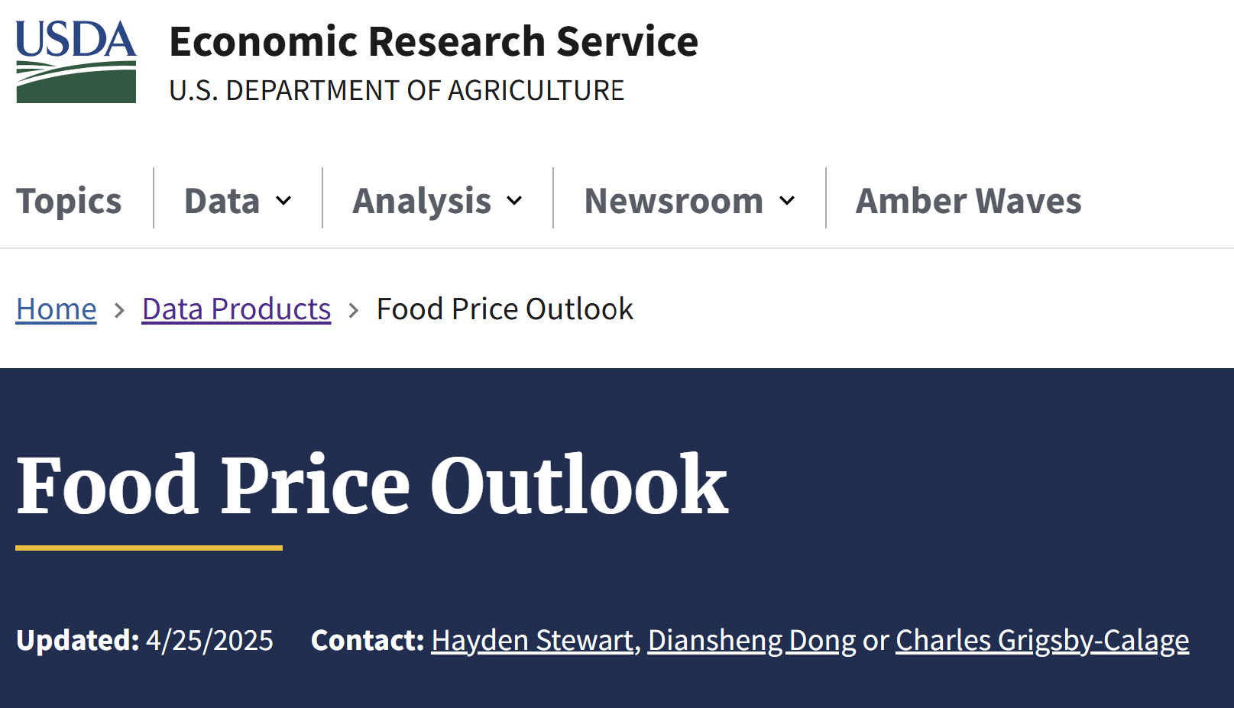
Overview and Dataset
Goal: Explore, visualize, and compare consumer price index and producer price index data
Purpose: help users analyze inflation trends and forecast accuracy
Dataset: USDA Economic Research - Food Price Outlook
Eight total CSV files…
Historical CPI & PPI values
Forecasts uses old and new methodology
Archived forecast records

Slide 3
Application Features
Generate line graphs for CPI/PPI
Filter by year, category, or item
View full data tables
Analyze volatility and forecast accuracy
All one seamless GUI!
⬆️ Do not use JFrame or JFreeChart if you want less than 1000 lines of code…

Slide 4

One Seamless GUI
All the graphs, filters, tables, and queries are all on one interface
Switching between forecasts, historical records, or analysis tabs is (relatively) seamless
Really user-friendly experience

Slide 5
Repository:
https://github.com/godlaska/Price-Visualizer

